Slide 1
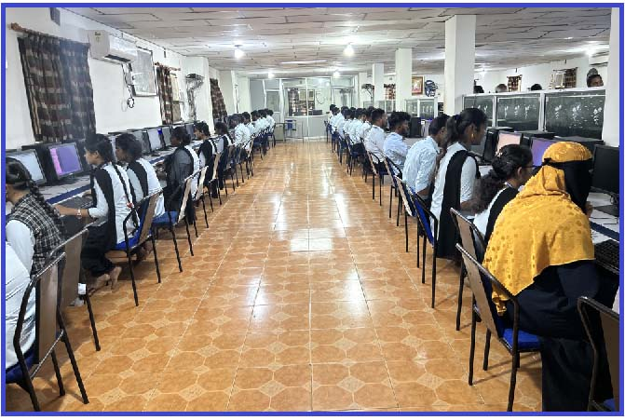
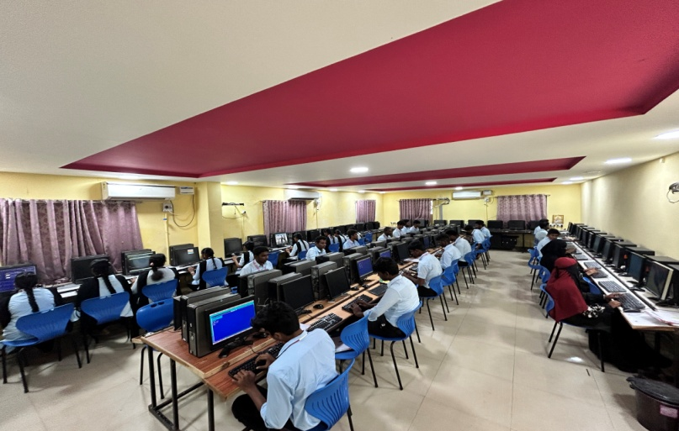
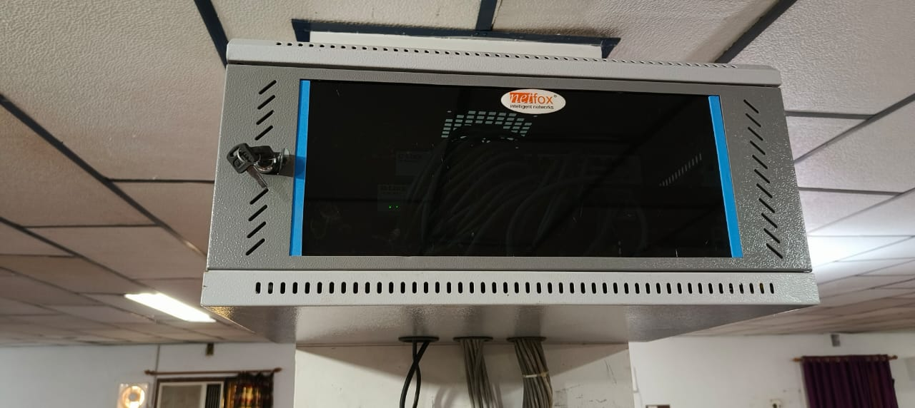
IT INFRASTRUCTURE
S. No | Name of the IT Facility | No. of Availability
1. | Computers | 148
2. | Routers & Modems | 10
3. | Hubs & Switches | 10
4. | Anti virus | Yes
5. | Webcams | 20
6. | Internet Speed | 100 Mbps
7. | Printers | 05
All the computers in all computer centers are established with a good network with high end xeon servers and have a good internet connectivity of 100 MBPS speed
Student Computer Ratio – 4 : 1
IT Policy is in place

Slide 2
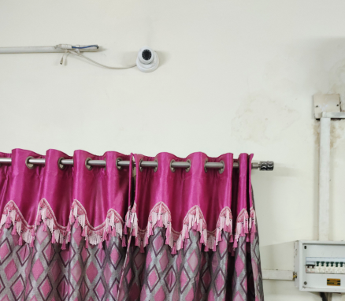
IT Infrastructure
CC Camera Surveillance

Slide 3
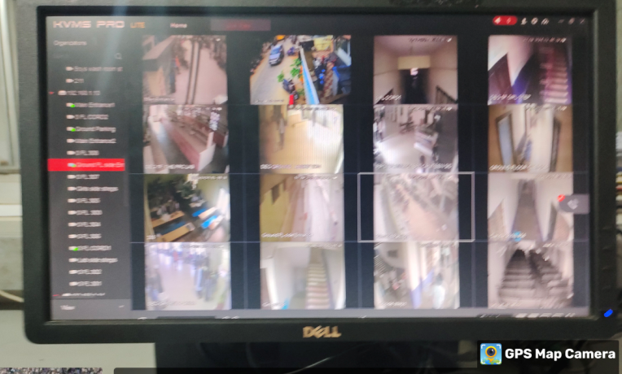
CCTV

Slide 4
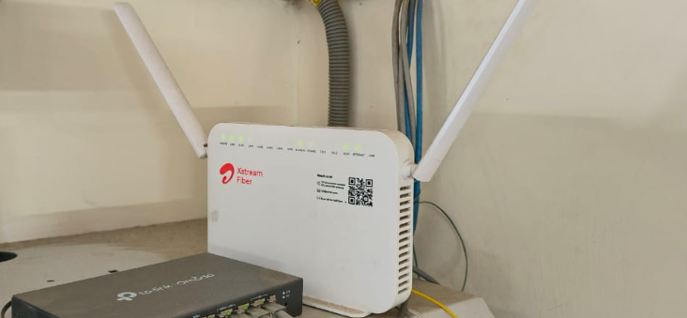
Wi-Fi

Slide 5
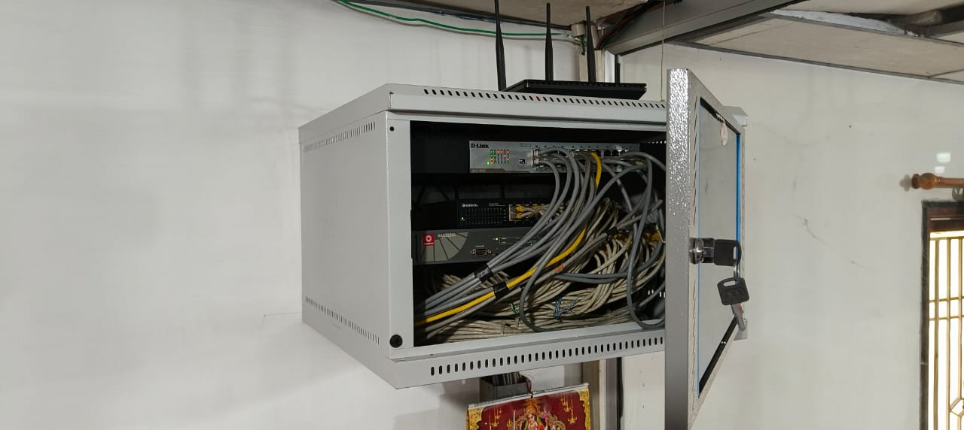
Hub

